Slide 1
Conservation of Mechanical Energy in a Vertical Spring

Slide 2
Objectives
Verifying Hooke’s law and determining the Spring Coefficient k.
Demonstrating and Verifying the conservation of Energy using a Vertical Spring.

Slide 3
Forces on the spring
When a mass is hanged . There are two forces acting on the spring:
- A force upwards called Hooke’s force F=-kx
- A gravitational force downwards F=mg
At the Equilibrium position ( Fig. b) the net force is 0 so mg=kx

Slide 4
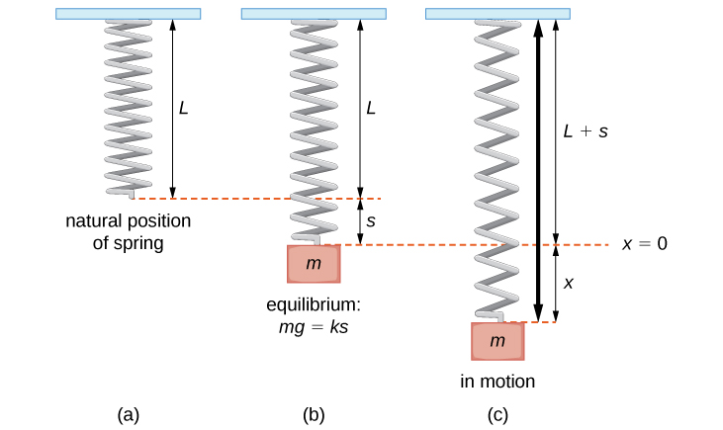
Vertical Spring

Slide 5
Conservation of energy
There are 3 forms of energy : Kinetic energy , gravitational potential energy and elastic potential energy.
When the spring is stretched as in fig. ( c ) it oscillates converting the different type of energies to each other, with the total energy conserved at all points.

Slide 6
Conservation of energy

Slide 7
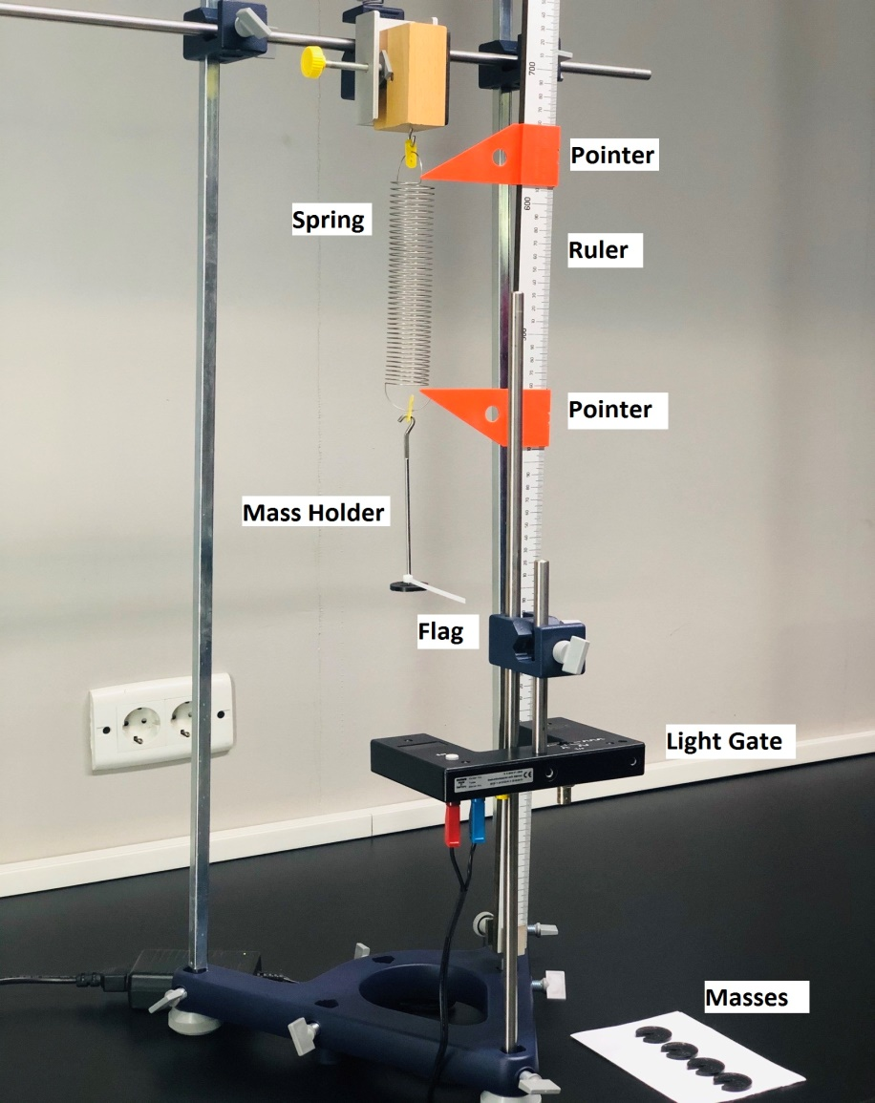
Setup

Slide 8
Tasks
Task 1 : Verification of Hooke’s law and computing the spring coefficient k.
Task 2 : Relation between Speed and Displacement from equilibrium with constant Mass.
Task 3 : Relation between Speed and Mass with constant Displacement from equilibrium.

Slide 9
Objectives
Verifying Hooke’s law and determining the Spring Coefficient k.
Demonstrating and Verifying the conservation of Energy using a Vertical Spring.

